Slide 1
Decision Tree based Employee Churn Prediction
Presented by -
Ankit Kumar Pradhan
A Deepak

Slide 2
Table Of Contents
Introduction
Problem Description
Data set
Flow chart
Result
Conclusion
References

Slide 3
Introduction
Large companies have many employees.
Taking care of the needs and satisfaction of each employee is a challenging task to do
Valuable and talented employees leave the company without giving the proper reason.
Employee churn affects its overall revenue and brand image of the organization.

Slide 4
Problem Description
This project emphasizes on predicting churn of an employee within an organization such that whether the employee will leave the company or continue with it. It uses the data of previous employees who have worked for the company and by finding a pattern it predicts the churn in the form of yes or no.

Slide 5
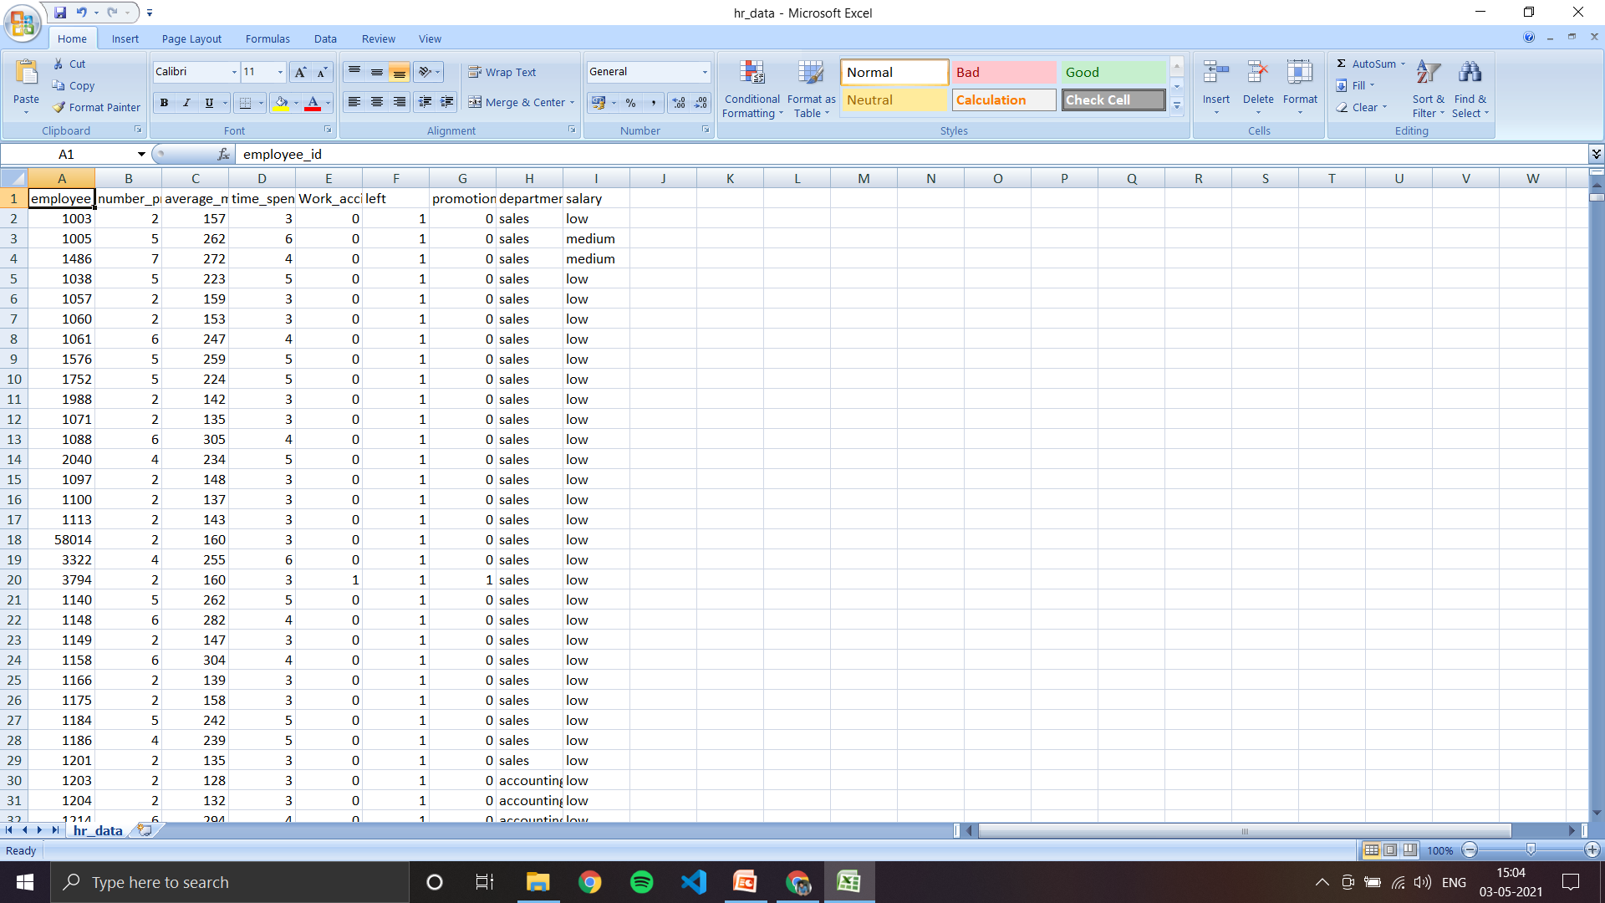
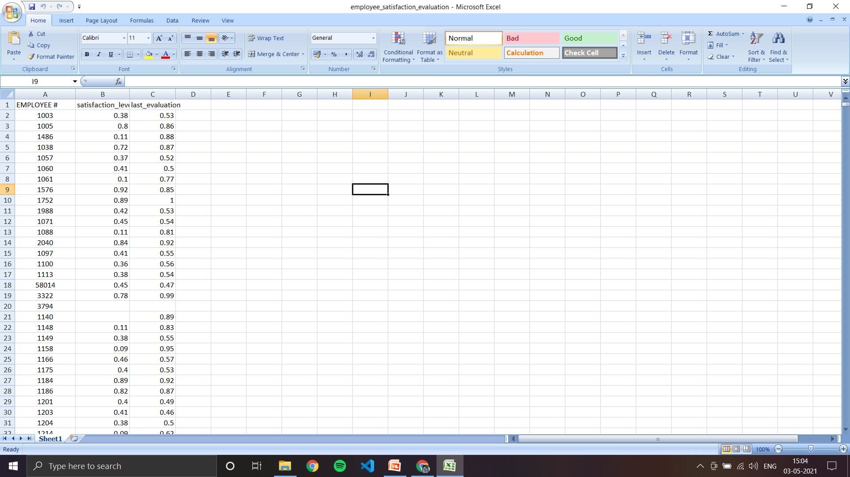
Data set collection
https://www.kaggle.com/liujiaqi/hr-comma-sepcsv
hr_data
employee_satisfaction_
evaluation

Slide 6
Flow Diagram
Importing packages
Loading datasets
Data preprocessing
Exploratory data analysis
Splitting of dataset into training and testing data set
Building model with the training and testing data set
Calculating accuracy
1
2
3
4
5
6
7

Slide 7

Result

Slide 8
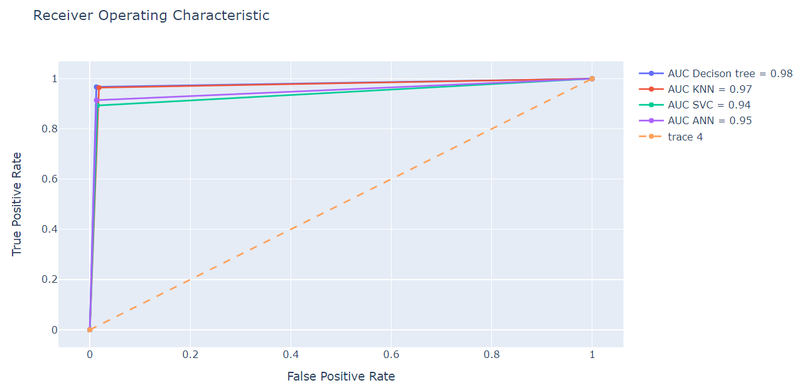

Slide 9
Conclusion
Employee churn leads to customer dissatisfaction. In this project, hr_data and employee_satisfaction_evaluation datasets have been considered. Different machine learning algorithms, Decision tree , KNN, SVM, and ANN have been used to find out which employee is going to quit the respective organization based on their working details and environments. Different performance measures like confusion matrix and overall accuracy have been used. From the experimental results, Decision tree is found to be better as compared to other models considered in this study. Thus, this model can be used for the real life applications.

Slide 10
References
[1] Yiğit, İbrahim Onuralp, and Hamed Shourabizadeh. "An approach for predicting employee churn by using data mining." 2017 International Artificial Intelligence and Data Processing Symposium (IDAP). IEEE, 2017.
[2] Saradhi, V. Vijaya, and Girish Keshav Palshikar. "Employee churn prediction." Expert Systems with Applications 38.3 (2011): 1999-2006.
[3] Sisodia, Dilip Singh, Somdutta Vishwakarma, and Abinash Pujahari. "Evaluation of machine learning models for employee churn prediction." 2017 International Conference on Inventive Computing and Informatics (ICICI). IEEE, 2017
[4] Dolatabadi, Sepideh Hassankhani, and Farshid Keynia. "Designing of customer and employee churn prediction model based on data mining method and neural predictor." 2017 2nd International Conference on Computer and Communication Systems (ICCCS). IEEE, 2017.
[5] Alamsyah, Andry, and Nisrina Salma. "A comparative study of employee churn prediction model." 2018 4th International Conference on Science and Technology (ICST). IEEE, 2018.
[6] Jain, Nishant, Abhinav Tomar, and Prasanta K. Jana. "A novel scheme for employee churn problem using multi-attribute decision making approach and machine learning." Journal of Intelligent Information Systems 56.2 (2021): 279-302.
[7] Srivastava, Praveen Ranjan, and Prajwal Eachempati. "Intelligent Employee Retention System for Attrition Rate Analysis and Churn Prediction: An Ensemble Machine Learning and Multi-Criteria Decision-Making Approach." Journal of Global Information Management (JGIM) 29.6 (2021): 1-29.
[8] Ajit, Pankaj. "Prediction of employee turnover in organizations using machine learning algorithms." algorithms 4.5 (2016): C5.
[9] Jain, Himani, Garima Yadav, and R. Manoov. "Churn Prediction and Retention in Banking, Telecom and IT Sectors Using Machine Learning Techniques." Advances in Machine Learning and Computational Intelligence. Springer, Singapore, 2021. 137-156.
[10] Khera, Shikha N., and Divya. "Predictive modelling of employee turnover in Indian IT industry using machine learning techniques." Vision 23.1 (2018): 12-21.

Slide 11
THANK YOU

